Slide 1
Data analysis
with Python

Slide 2
Pre-processing Data in Python

Slide 3
Data Pre-processing
Also known as:
Data cleaning, Data wrangling
It is the process of converting or mapping data from one “raw” form into another format, to make it ready for further analysis.

Slide 4
Learning Objectives
• Identify and handle missing values
• Data Formatting
• Data Normalization (centering /scaling)
• Data Binning
• Turning Categorical values to numeric variables

Slide 5
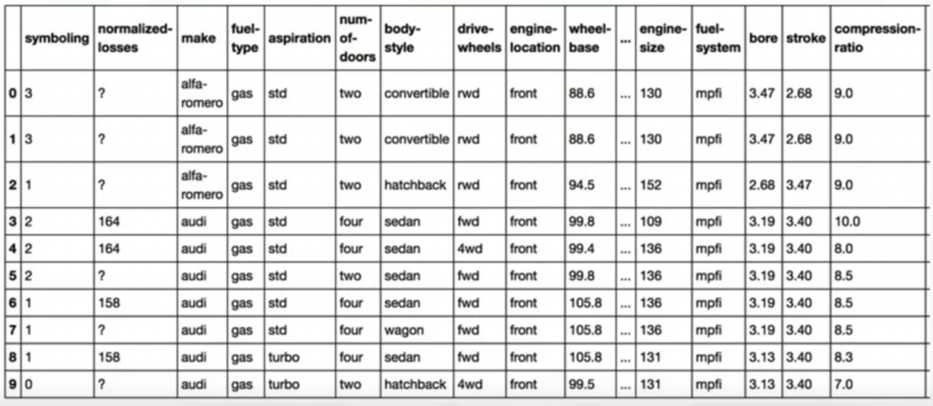
Simple Dataframe Operations

Slide 6
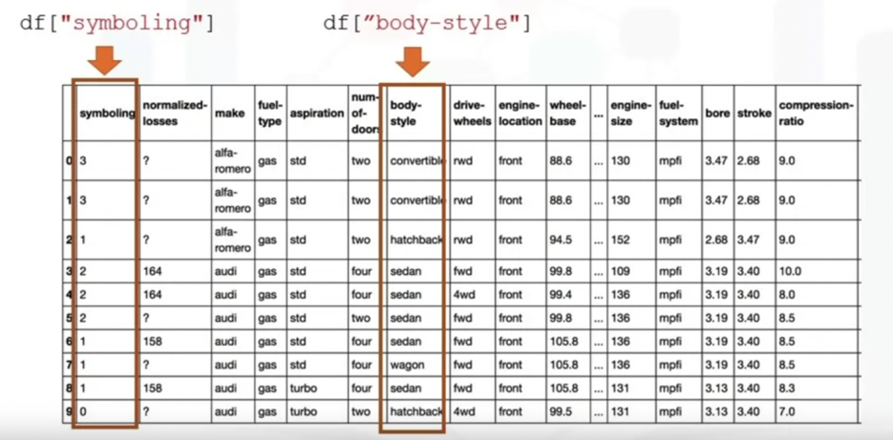
Simple Dataframe Operations

Slide 7
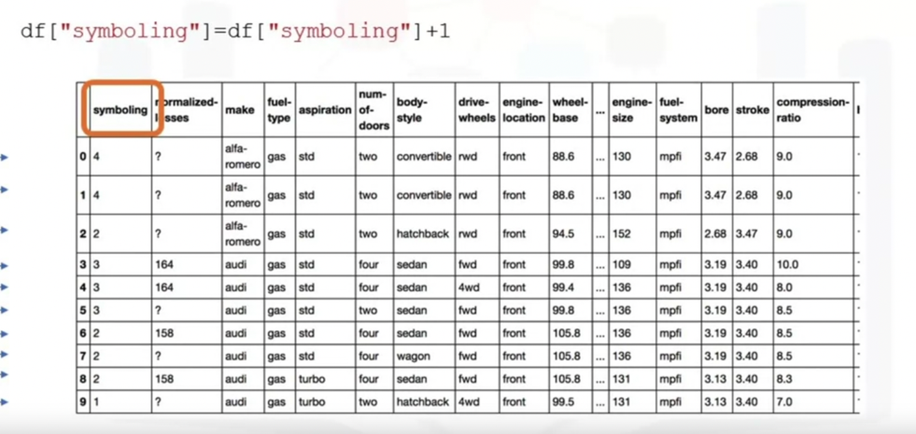
Simple Dataframe Operations

Slide 8
Dealing with Missing Values in Python

Slide 9
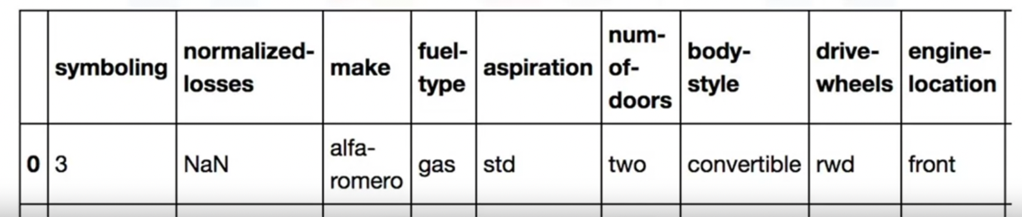
Missing Values
What is missing value?
Missing values occur when no data value is stored for a variable (feature) in an observation.
Could be represented as "?", "N/A', O or just a blank cell.
Notes:
Usually missing value in data set appears as question mark and a zero or just a blank cell.
In the example here, the normalized losses feature has a missing value which is represented with NaN.

Slide 10
How to deal with missing data
Check with the data collection source
Drop the missing values
drop the variable
drop the data entry
Replace the missing values
replace it with an average (of similar datapoints)
replace it by frequency
replace it based on other functions
Leave it as missing data
Notes:
Many ways to deal with missing values regardless of Python, R or whatever tool.
Each situation different and should be judged differently.
1) check if the person or group that collected the data can go back and find what the actual value should be.
2) remove the data where that missing value is found. When drop data, either drop the whole variable or just the single data entry with the missing value.
If you don't have a lot of observations with missing data, usually dropping the particular entry is the best.
If you're removing data, you want to look to do something that has the least amount of impact.
Replacing data is better since no data is wasted.
However, it is less accurate since we need to replace missing data with a guess of what the data should be.
One standard for placement technique is to replace missing values by the average value of the entire variable.
As an example, suppose we have some entries that have missing values for
the normalized losses column and the column average for entries with data is 4500.
While there is no way for us to get an accurate guess of what
the missing value is under the normalized losses column should have been,
you can approximate their values using the average value of the column 4500.
But what if the values cannot be averaged as with categorical variables?
For a variable like fuel type,
there isn't an average fuel type since the variable values are not numbers.
In this case, one possibility is to try using the mode,
the most common like gasoline.
Finally, sometimes we may find another way to guess the missing data.
This is usually because the data gathered
knows something additional about the missing data.
For example, he may know that the missing values tend to be
old cars and the normalized losses of
old cars are significantly higher than the average vehicle.
And of course, finally,
in some cases you may simply want to leave the missing data as missing data.
For one reason or another,
it may be useful to keep that observation even if some features are missing.

Slide 11
Question: How would you deal with missing values for categorical data?
replace the missing value with the mode of the particular column
replace the missing value with the mean of the particular column
replace the missing value with the value that appears most often of the particular column
Notes:
Answer: 1 and 3

Slide 12
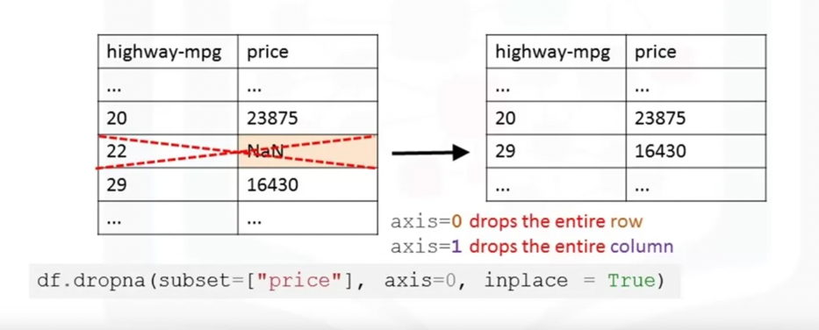
How to drop missing values in Python
Use dataframes.dropna()
Notes:
-dropna method
-specify axis
-price remove,
-inplace = true (directly changes dataframe)

Slide 13
Don’t forget
http://pandas.pydata.org/
Notes:
-first one doesn’t modify dataframe (good for checking)
-to modify use second line
-check documentation for methods

Slide 14
Question: What does this code do to the dataframe df?
df.dropna(axis=0)
replaces all values nan with the mean
drops all rows that contain a nan
drops all columns that contain a nan
Notes:
Answer 2: drop all rows that contain a NaN

Slide 15
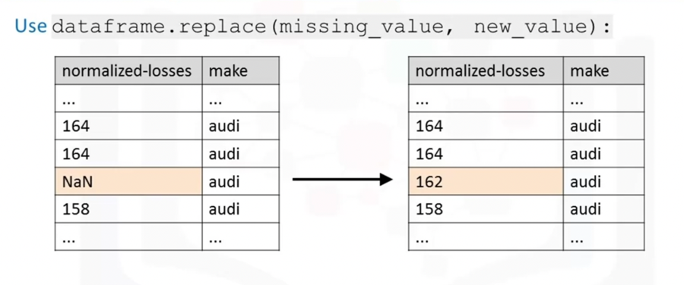
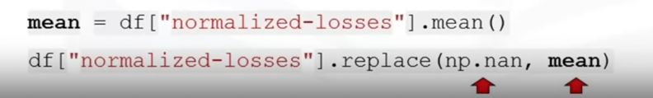
How to replace missing values in Python
Notes:
Normalized losses replaced by average values of the column
First calculate mean
First parameter what we want to replace
Second parameter what we replace with

Slide 16
How to deal with missing data
Check with the data collection source
Drop the missing values
drop the variable
drop the data entry
Replace the missing values
replace it with an average (of similar datapoints)
replace it by frequency
replace it based on other functions
Leave it as missing data
Notes:
Can always check for a higher quality data set or source or in some cases you may want to leave the missing data as missing data.

Slide 17
Data formatting
Notes:
we'll look at the problem of data with different formats,
units and conventions and the pandas methods that help us deal with these issues.

Slide 18
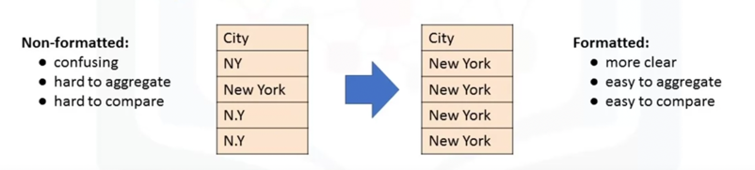
Data formatting
Data are usually collected from different places and stored in different formats.
Bringing data into a common standard of expression allows users to make meaningful comparison.
Notes:
Data is usually collected from different places by different people which may be stored in different formats.
Data formatting means bringing data into a common standard of expression that allows users to make meaningful comparisons.
As a part of dataset cleaning, data formatting ensures the data is consistent and easily understandable.
For example, people may use different expressions to represent New York City, such as uppercase N uppercase Y, uppercase N lowercase y, uppercase N uppercase Y and New York.
Sometimes, this unclean data is a good thing to see.
For example, if you're looking at the different ways people tend to write New York, then this is exactly the data that you want.
Or if you're looking for ways to spot fraud, perhaps writing N.Y. is more likely to predict an anomaly than if someone wrote out New York in full.
But perhaps more often than not, we just simply want to treat them all as the same entity or format to make statistical analyses easier down the road.

Slide 19
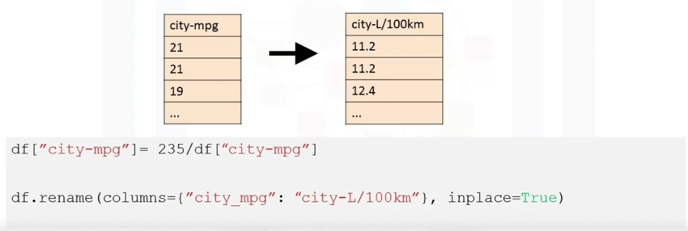
Applying calculations to an entire column
Convert “mpg” to “L/100km” in Car dataset
Notes:
Referring to our used car dataset, there's a feature named city-miles per gallon in the dataset, which refers to a car fuel consumption in miles per gallon unit.
However, you may be someone who lives in a country that uses metric units.
So, you would want to convert those values to liters per 100 kilometers, the metric version.
To transform miles per gallon to liters per 100 kilometers, we need to divide 235 by each value in the city-miles per gallon column.
In Python, this can easily be done in one line of code. You take the column and set it to equal to 235, divide it by the entire column.
In the second line of code, rename column name from city-miles per gallon to city-liters per 100 kilometers using the data frame rename method.

Slide 20
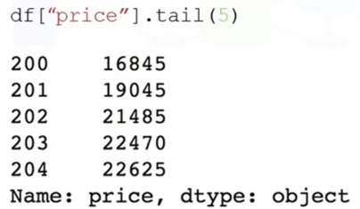
Incorrect data types
Sometimes the wrong data type is assigned to a feature.
Notes:
For a number of reasons, including when you import a dataset into Python, the data type may be incorrectly established.
For example, here we noticed the assigned data type to the price feature is object.
Although the expected data type should really be an integer or float type.
It is important for later analysis to explore the features data type and convert them to the correct data types.
Otherwise, the developed models later on may behave strangely, and totally valid data may end up being treated like missing data.

Slide 21
Data Types in Python and Pandas
There are many data types in pandas
Objects: "A", "Hello".
Int64 : 1,3,5
Float64: 2.123, 632.31,0.12

Slide 22
Correcting data types
To identify data types:
Use dataframe.dtypes () to identify data type.
To convert data types:
Use dataframe. astype () to convert data type.
Example: convert data type to integer in column "price"

Slide 23
Question: What does the code perform?
df[["price"]] = df[["price"]].astype("float")
Notes:
cast the column price to a float

Slide 24
Data Normalization in Python
Notes:
we'll look at the problem of data with different formats,
units and conventions and the pandas methods that help us deal with these issues.

Slide 25
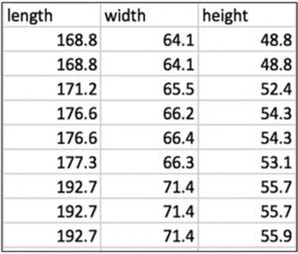
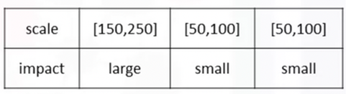
Data Normalization
Uniform the features value with different range.
Notes:
When we take a look at the used car data set, we notice feature “length” ranges from 150-250, while feature width and height ranges from 50-100.
We may want to normalize these variables so that the range of the values is consistent.
This normalization can make some statistical analyses easier down the road.
By making the ranges consistent between variables, normalization enables a fair comparison between the different features, making sure they have the same impact.
It is also important for computational reasons.

Slide 26
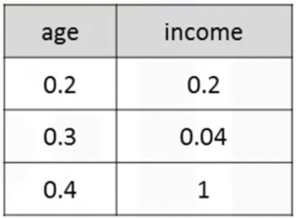
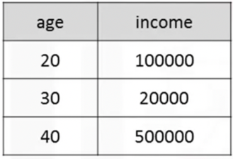
Data Normalization
Not-normalized
"age" and "income" are in different range.
hard to compare
"income" will influence the result more
Normalized
similar value range
similar intrinsic influence on analytical model
Notes:
Consider a data set containing two features, age and income.
Age ranges from 0-100, income ranges from 0-20,000 and higher.
Income is about 1,000 times larger than age and ranges from 20,000-500,000.
So, these two features are in very different ranges.
When we do further analysis, like linear regression for example, the attribute income will intrinsically influence the result more due to its larger value.
But this doesn't necessarily mean it is more important as a predictor.
So, the nature of the data biases the linear regression model to weigh income more heavily than age.
To avoid this, we can normalize these two variables into values that range from zero to one.
Compare the two tables at the right.
After normalization, both variables now have a similar influence on the models we will build later.

Slide 27
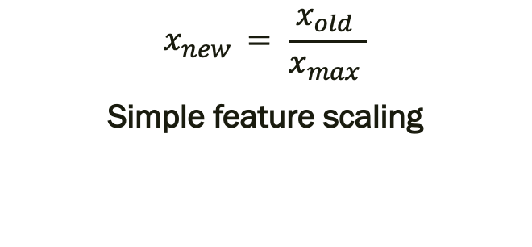
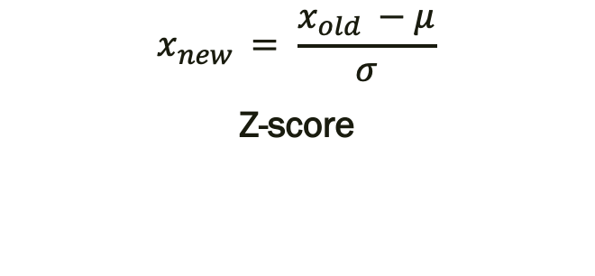
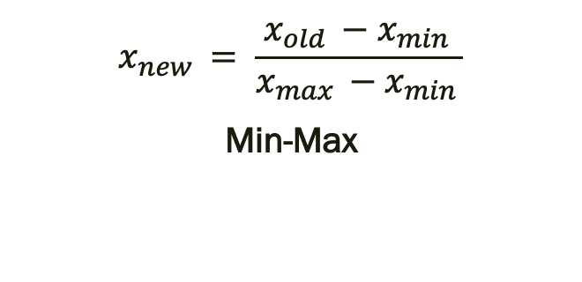
Methods of normalizing data
Several approaches for normalization:
$$x_{new }= \frac{x_{old }}{x_{max }}$$
Simple feature scaling
$$x_{new }= \frac{x_{old }−{ x}_{min }}{x_{max }−x_{min }}$$
Min-Max
$$x_{new }= \frac{x_{old }−μ}{σ}$$
Z-score
Notes:
Simple feature scaling just divides each value by the maximum value for that feature. This makes the new values range between zero and one.
The second method called min-max takes each value X_old subtract it from the minimum value of that feature, then divides by the range of that feature. Again, the resulting new values range between zero and one.
The third method is called z-score or standard score. In this formula for each value you subtract the mu which is the average of the feature, and then divide by the standard deviation sigma.
The resulting values hover around zero, and typically range between negative three and positive three but can be higher or lower

Slide 28
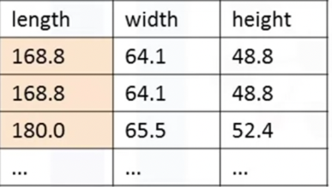
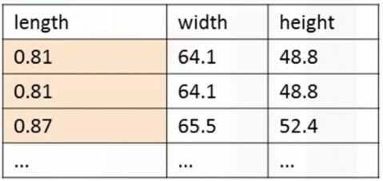
Simple feature scaling in Python
With pandas:
Notes:
Simple feature scaling just divides each value by the maximum value for that feature. This makes the new values range between zero and one.
The second method called min-max takes each value X_old subtract it from the minimum value of that feature, then divides by the range of that feature. Again, the resulting new values range between zero and one.
The third method is called z-score or standard score. In this formula for each value you subtract the mu which is the average of the feature, and then divide by the standard deviation sigma.
The resulting values hover around zero, and typically range between negative three and positive three but can be higher or lower

Slide 29
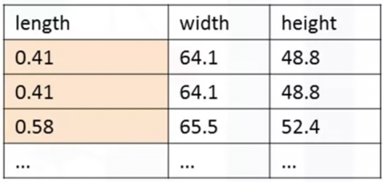
Min-max in Python
With pandas:

Slide 30
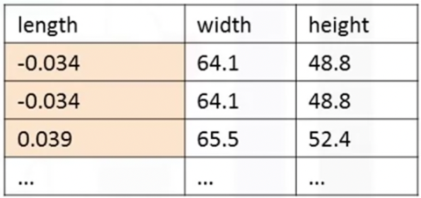
Z-score in Python
With pandas:

Slide 31
Binning in Python
Notes:
we'll look at the problem of data with different formats,
units and conventions and the pandas methods that help us deal with these issues.

Slide 32
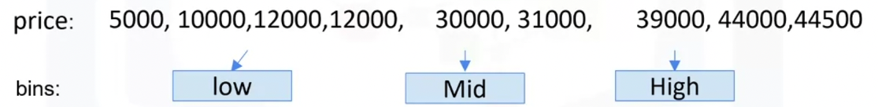
How to deal with missing data
Binning: Grouping of values into "bins"
Converts numeric into categorical variables
Group a set of numerical values into a set of "bins”
"price" is a feature range from 5,000 to 45,500 (in order to have a better representation of price)
Notes:
You can bin “age” into [0 to 5], [6 to 10], [11 to 15] and so on.
Sometimes, binning can improve accuracy of the predictive models.
In addition, sometimes we use data binning to group a set of numerical values into a smaller number of bins to have a better understanding of the data distribution.
As example, “price” here is an attribute range from 5,000 to 45,500.
Using binning, we categorize the price into three bins: low price, medium price, and high prices.

Slide 33
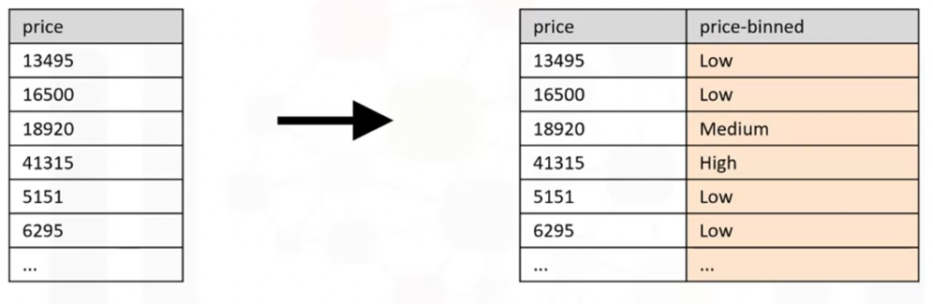
Binning in Python pandas
Notes:
In the actual car dataset, ”price" is a numerical variable ranging from 5188 to 45400, it has 201 unique values.
We can categorize them into 3 bins: low, medium, and high-priced cars.
In Python we can easily implement the binning: We would like 3 bins of equal binwidth, so we need 4 numbers as dividers that are equal distance apart.
First we use the numpy function “linspace” to return the array “bins” that contains 4 equally spaced numbers over the specified interval of the price.
We create a list “group_names “ that contains the different bin names.
We use the pandas function ”cut” to segment and sort the data values into bins.

Slide 34
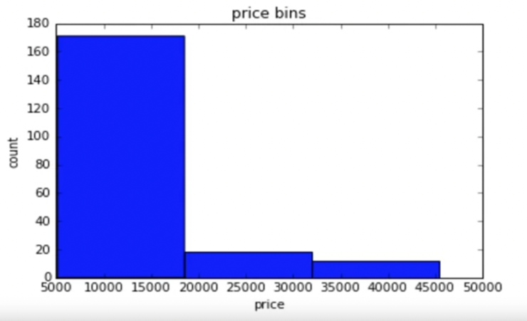
Visualizing binned data
E.g., Histograms
Notes:
This is the histogram that we plotted based on the binning that we applied in the price feature.
From the plot, it is clear that most cars have a low price, and only very few cars have high price.

Slide 35
Turning categorical variables into quantitative variables in Python

Slide 36
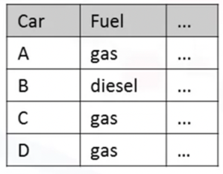
Categorical Variables
Problem:
Most statistical models cannot take in objects or strings as input and for model training only take the numbers as inputs.

Slide 37
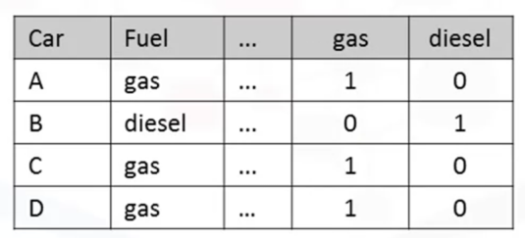
Categorical -> Numeric
Solution:
Add dummy variables for each unique category
Assign 0 or 1 in each category
”One-hot encoding”
Notes:
Answer: 1 and 3

Slide 38
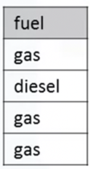
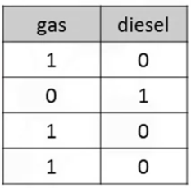
Dummy varibles in Python pandas
Use pandas.get_dummies() method.
Convert categorical variables to dummy variables (0 or 1)
Notes:
In Pandas, we can use get_dummies method to convert categorical variables to dummy variables.
In Python, transforming categorical variables to dummy variables is simple.
Following the example, pd.get_dummies method gets the fuel type column and creates the data frame dummy_variable_1.
The get_dummies method automatically generates a list of numbers, each one corresponding to a particular category of the variable.

Slide 39
Lesson Summary
In this lesson, you have learned how to:
Identify and Handle Missing Values: Drop rows with incomplete information and impute missing data using the mean values.
Understand Data Formatting: Wrangle features in a dataset and make them meaningful for data analysis.
Apply normalization to a data set: By understanding the relevance of using feature scaling on your data and how normalization and standardization have varying effects on your data analysis.

